Slide 1
Opines

Slide 2
Opines
References:
AR 195–2 Criminal Investigation Activities
AR 27–10 Military Justice
DoDI 5505.03
DoDI 5505.11 Fingerprint Card and Final Disposition Report Submission Requirements
DoDI 5505.14, Deoxyribonucleic Acid (DNA) Collection Requirements for Criminal Investigations, Law Enforcement, Corrections, and Commanders c
DoDI 7730.47 (Defense Incident-Based Reporting System (DIBRS), 23 January 2014.
DoDI 5505.03 (Initiation of Investigations by Defense Criminal Investigative Organizations), 24 March 2011, with change 1, 22 December 2015.

Slide 3
Opines
References:
DoDI 4000.19 (Support Agreements), 25 April 2013.
DoDI 6495.02 (Sexual Assault Prevention and Response (SAPR) Program Procedures
MOA between OTJAG and CID dated 20180605, expires 1 October 22.

Slide 4
Opines
“The probable cause opine. The probable cause opine can be made at any time during the investigation. The purpose of the probable cause opine is to allow law enforcement personnel to satisfy the requirements for entering data into the Combined Deoxyribonucleic Acid Index System (CODIS, DoDI 5505.14); the Criminal Justice Information Services (CJIS, DoDI 5505.11); and the Defense Incident-Based Reporting System (DIBRS, DoDI 7730.47). A probable cause opine advances the CID investigation. Without a probable cause opine, potential investigative leads resulting from fingerprint and DNA analyses cannot be pursued. A probable cause opine allows for the submission of fingerprints to the National Crime Information Center (NCIC), a critical first step in providing criminal justice information to federal databases and to the SA. However, the probable cause opine is not a sufficient basis, by itself, to produce a final report. The probable cause opinion is separate and distinct from a recommendation for disposition for judicial, non-judicial or administrative actions to be taken by a commander. If additional investigative leads are developed after the final report is dispatched, a supplemental report must be initiated.”
-Excerpt from OTJAG and CID MOA

Slide 5
Opines
“The probable cause opine. The probable cause opine can be made at any time during the investigation. The purpose of the probable cause opine is to allow law enforcement personnel to satisfy the requirements for entering data into the Combined Deoxyribonucleic Acid Index System (CODIS, DoDI 5505.14); the Criminal Justice Information Services (CJIS, DoDI 5505.11); and the Defense Incident-Based Reporting System (DIBRS, DoDI 7730.47). A probable cause opine advances the CID investigation. Without a probable cause opine, potential investigative leads resulting from fingerprint and DNA analyses cannot be pursued. A probable cause opine allows for the submission of fingerprints to the National Crime Information Center (NCIC), a critical first step in providing criminal justice information to federal databases and to the SA. However, the probable cause opine is not a sufficient basis, by itself, to produce a final report. The probable cause opinion is separate and distinct from a recommendation for disposition for judicial, non-judicial or administrative actions to be taken by a commander. If additional investigative leads are developed after the final report is dispatched, a supplemental report must be initiated.”
-Excerpt from OTJAG and CID MOA

Slide 6
Opines
When?
When requested by the SA, the TC shall provide a probable cause opine or final report opine with in 14 calendar days after the SA has presented the supporting facts to the TC. If a disagreement exists between the SA and TC, then the SA must request a determination be made by the Chief of Military Justice (or the TC's appropriate supervising attorney) in conjunction with the Special Agent in Charge (SAC), who will have 14 additional days to review the case and provide a probable cause or final report opine.

Slide 7
Opines
Before issuing PC Opine:
Review case file with an eye on “how can this evidence come into court?”
Talk to your TC (or equivalent) about the case
Have a senior review, if possible
Ensure there are no additional leads to follow up on, if it is a case which might go to trial.
For example: Are there med. records out there? Did anyone talk to the EMT? 911 call?
Anyone ask the neighbors? The co-workers? Etc….

Slide 8
No PC Opine:
An opine of no probable cause may be given ONLY in the following cases, No Probable Cause (False) and No Probable Cause (Failure to substantiate all elements of the offense)

Slide 9
No PC Opine (Cont):
No Probable Cause (False): The evidence shows that an offense was not actually committed or attempted by the subject of the investigation.
Essentially, the person reporting the crime made it up. Super Rare.

Slide 10
No PC Opine (Cont):
No Probable Cause (Failure to substantiate all elements of the offense):
Most Common No PC Opine.
Example: Article 120(d) Sexual Assault Without Consent.
(i) That the accused committed a sexual act
upon another person; and
(ii) That the accused did so without the consent
of the other person.

Slide 11
No PC Opine (Cont):
Article 120(d) Sexual Assault Without Consent. (Example No PC)
(i) That the accused committed a sexual act
upon another person; and
AV has a “vague memory” of suspect trying to kiss in the middle of the night, awakes in the a.m., fully clothed, with suspect in same bed, she under covers, him on top of covers. Also, despite drinking, AV changed clothes and went to bed in the shared Air B&B. No DNA (or lube) in any place it shouldn’t be.
(ii) That the accused did so without the consent
of the other person.

Slide 12
No PC Opine (Cont):
Article 120(d) Sexual Assault Without Consent. (Example 2 No PC)
(i) That the accused committed a sexual act
upon another person; and
(ii) That the accused did so without the consent
of the other person.
The investigation produces evidence of the consensual nature of the engagement(s), ie. texts after the alleged event, social media posts, witnesses, etc…

Slide 13
No PC Opine (Cont):
When issuing No PC Opine for 120 cases:
Ensure all leads have been closed out
Have Special Victim Prosecutor review
Run it by your Chief of Justice or other supervisor
Do you need SJA/senior counsel buy in?
Ensure victim / SVC is informed of the decision
DOCUMENT. You wont remember why you said No PC a year from now, so do future you a solid: write it down, and save it.

Slide 14
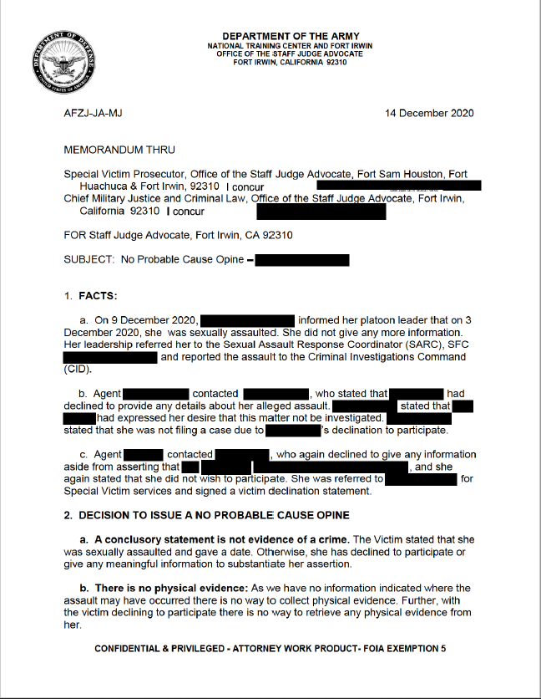
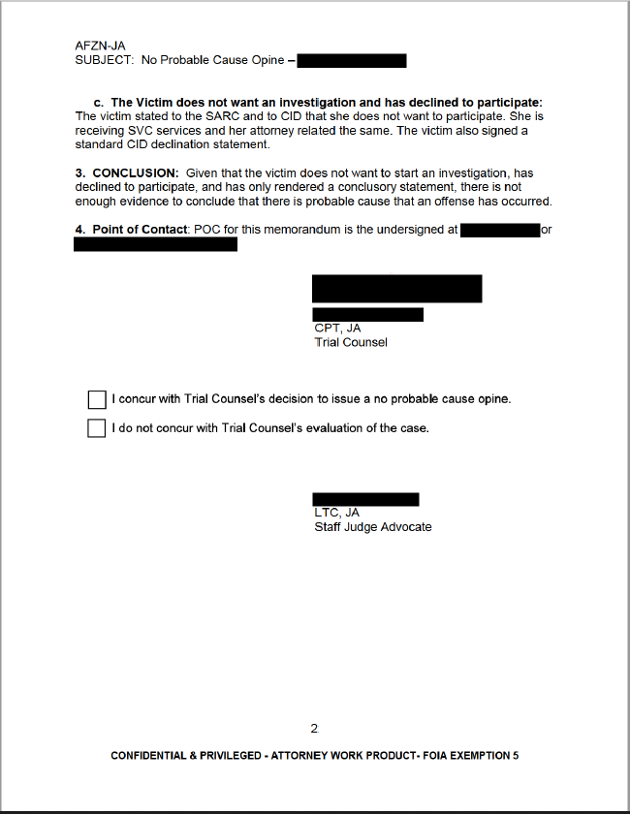
No PC Opine (Cont) Documenting

Slide 15
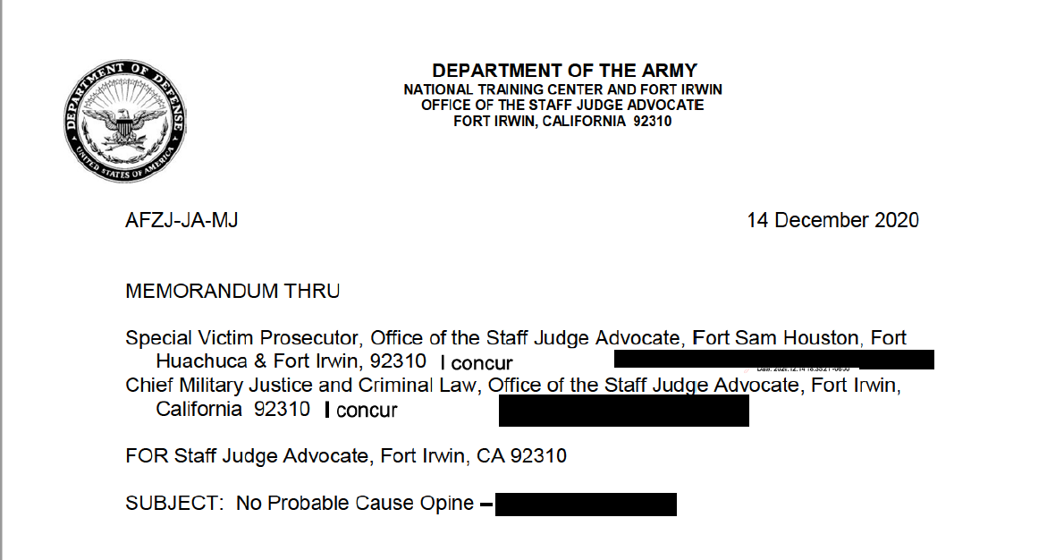

Slide 16
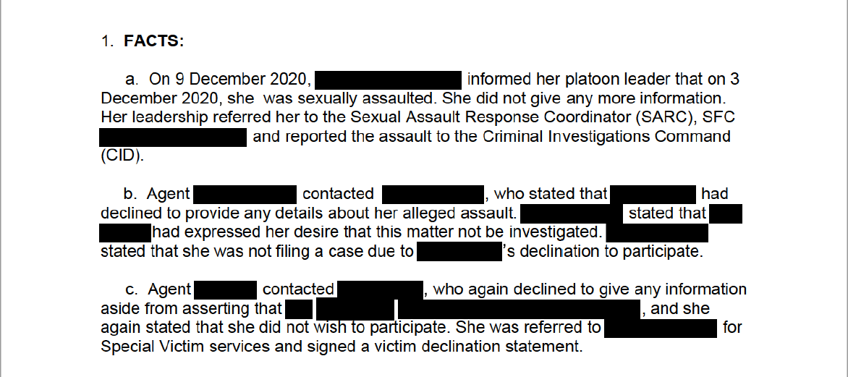

Slide 17
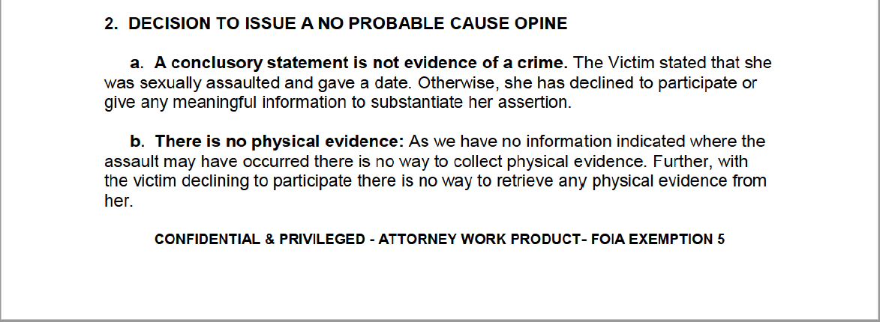

Slide 18
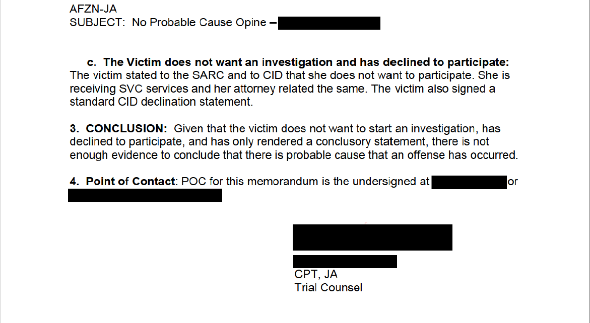

Slide 19
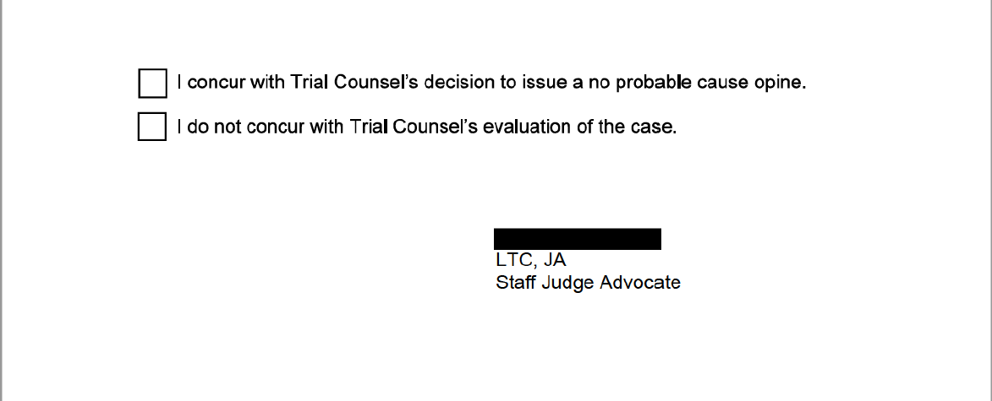

Slide 20
Opines
Questions?

